Slide 1
Water Surface & Sink Detection Based on DEM
C++ with GDAL
By Caiyi Zhong
May. 6th, 2014

Slide 2
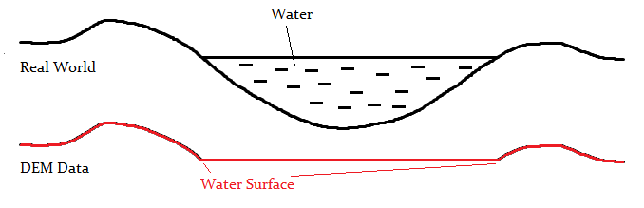
Intro: What are water surfaces?
In some kinds of DEM dataset, a water surface would be like this:
Rather flat area (allow some tolerance)
Surroundings (Bank) should be higher than water surface itself

Slide 3
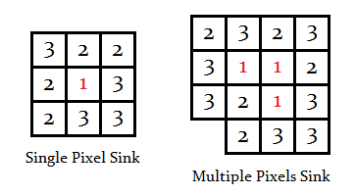
Intro: What are sinks?
A pixel whose neighbors (8-neighbor) are all higher than itself.
And we can extend this concept to multiple pixels.
Typically we use Flow Direction grid to calculate sinks. But in this case, assuming our Flow Direction won’t work due to our water surface issues.

Slide 4
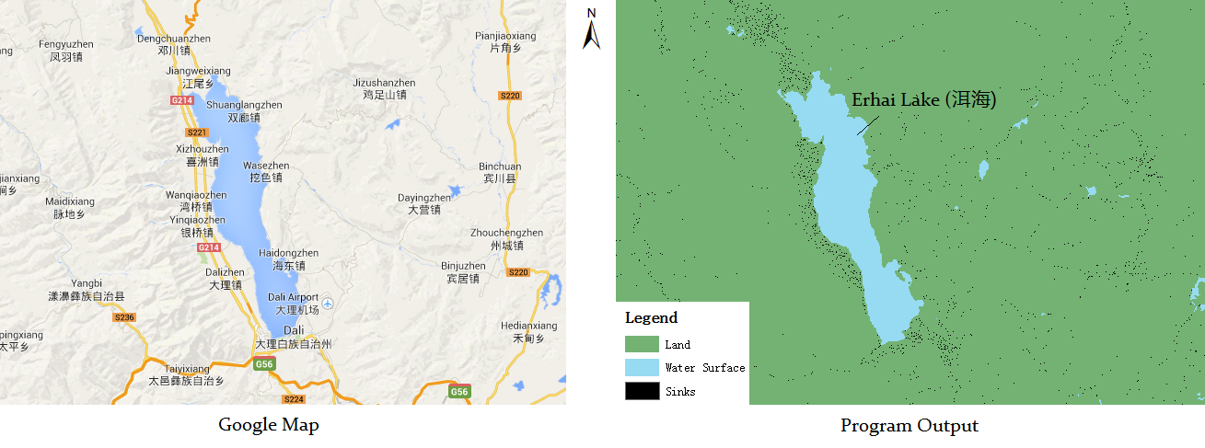
Intro: What we do?
The objective is, detect the water surface areas correctly.
Here is a sample detection of Erhai Lake, Yunnan Province, China

Slide 5
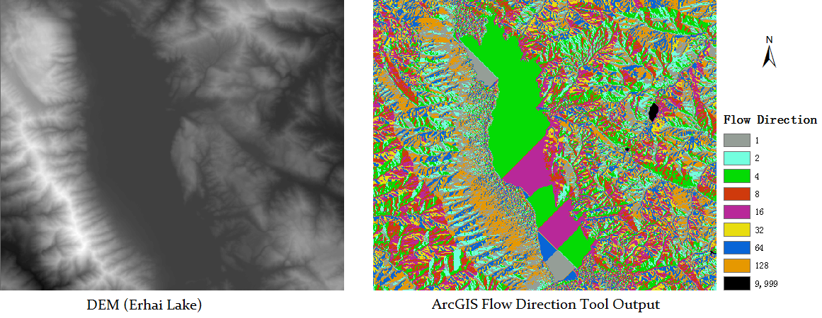
Flow Direction Issues
Water surfaces can dramatically affect the performance of Flow Direction analysis in ArcGIS.
What the hell is the 9,999s we got in Flow Direction?

Slide 6
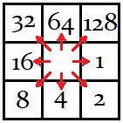
Flow Direction Issues
9,999 stands for non-power-of-2 outputs of Flow Direction.
An output of 9 means either the flow direction could be east, or southwest.
Possible cause of this issue:
ESRI Document says: If the maximum descent to several cells is the same, the neighborhood is enlarged until the steepest descent is found.
ArcGIS’s algorithm’s performance is not very good.

Slide 7
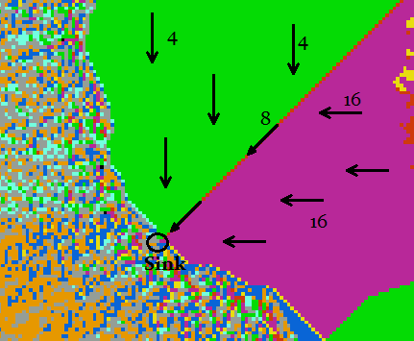
Flow Direction Issues
Sinks would also appear at the bank of a lake, making the flow direction like this:
This kind of sinks are probably the outlets of a lake.

Slide 8
Literature Review
Literature Review for Water Surface Detection:
multi-spectral remote sensing
LiDAR
I found nothing about only use DEM to do water surface detection.

Slide 9
Data, Tools and Environment
Data Source:
NASA 2003 DEM, Including China, 30 meters resolution
http://www.fengshui-168.com/thread-99833-1-1.html
In this case, I use the data of Yunnan Province as a sample.
Programming Language:
C++
Library:
GDAL - Geospatial Data Abstraction Library
http://www.gdal.org
Programming Tools and Environment
Microsoft Visual Studio 2012

Slide 10
Analysis and Methodology
Input: DEM data raster
Output: An integer raster indicating the detecting result
Result Macros:
#define WDRESULT_UNKNOWN 0
#define WDRESULT_LAND 1
#define WDRESULT_WATER 2
#define WDRESULT_SINK 3
Neighborhood Check Result Enumerations:
enum WDNeighborCheck {
WDNEIGHBOR_UNKNOWN, // Error or unchecked
WDNEIGHBOR_CAN_FLOW_DOWN, // One or more neighbor lower than px
WDNEIGHBOR_SINK, // All neighbors higher than px
WDNEIGHBOR_HALF_SINK, // Part of neighbors higher than px
WDNEIGHBOR_FLAT // All neighbors equal to px
};

Slide 11
Analysis and Methodology
Initialize: Fill a resultGrid with WDRESULT_UNKNOWN
for each non-processed px (i.e. pixel) in resultGrid
switch (CheckNeighbor(px))
case WDNEIGHBOR_CAN_FLOW_DOWN:
px = WDRESULT_LAND
case WDNEIGHBOR_SINK:
px = WDRESULT_SINK
case WDNEIGHBOR_HALF_SINK:
Floodfill(px, resultGrid)
default:
// Do nothing
end switch
end for
The function Floodfill(px, resultGrid) is just like the Paint Bucket tool in MS Paint. Here I use a quick algorithm called Queue-Linear Flood Fill by J. Dunlap

Slide 12
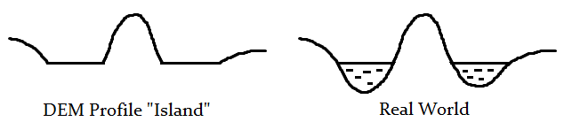
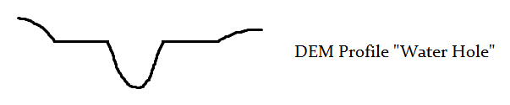
Analysis and Methodology
Assumptions:
Water surfaces is completely flat (allow some tolerance)
Water will flow down to lower area

Slide 13
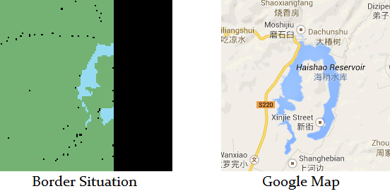
Analysis and Methodology
Border Situations:
Simply assume that the border is infinite high, so that when a water surface is cut by a border, the result could keep correct.

Slide 14
Analysis and Methodology
Parameters and their default values:
int pWaterPixelCountThreshold = 5;
double pEqualTolerance = 0.1;
double pOutletRateThreshold = 0.05;
Water Pixel Count Threshold:
In one Floodfill() operation, if the count of flood-filled pixel exceeds this value, then fill to WDRESULT_WATER, else WDRESULT_SINK .
Equal Tolerance:
If two elevation value’s absolute difference is equal or less than this tolerance, then regard the two as equal
Outlet Rate Threshold:
(See next page)

Slide 15
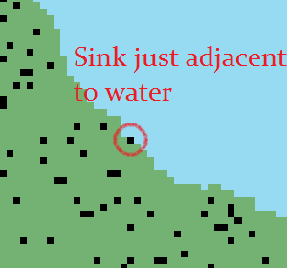
Analysis and Methodology
Parameters (cont’d)
Outlet Rate Threshold:
In real world data, there might be small amount of sinks that located just near the water.
If we follow the “Water Hole” rule, the whole lake should be assigned as land. This is not what we want.
Solution:
Use a ratio (number of pixels lower than water / number of pixels of water area) threshold. If the ratio is small enough, ignore them,

Slide 16
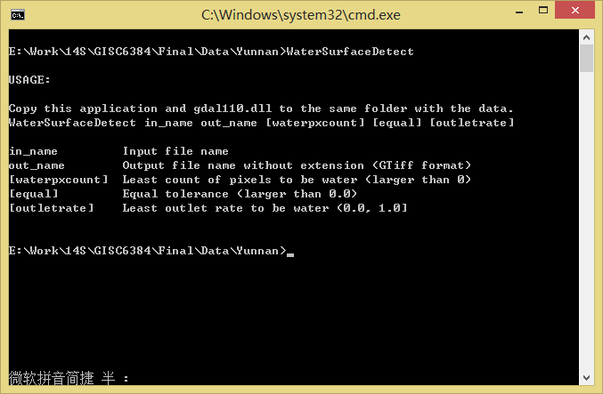
Implementation
Interface: A simple console application

Slide 17
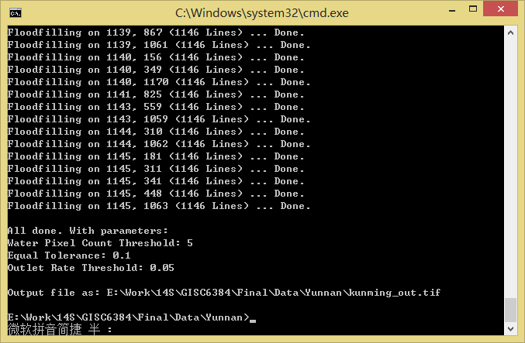
Implementation
Running…

Slide 18
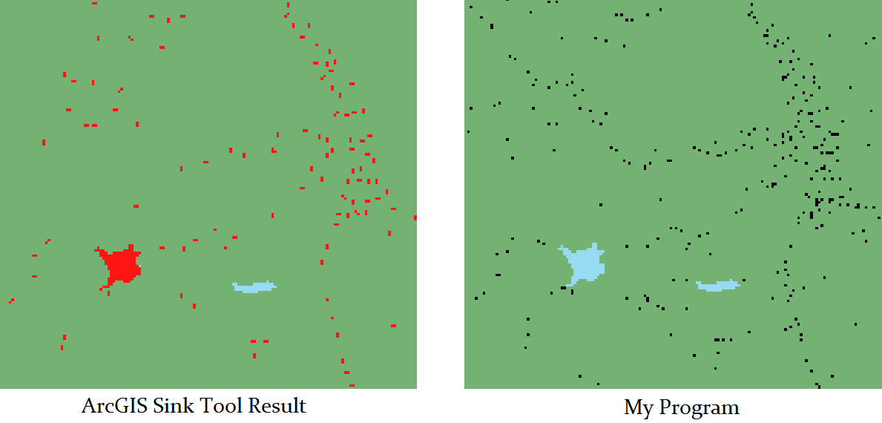
Compare with ArcGIS’ Sink
Number of Available Sinks:
Red: ArcGIS Sink tool output
Black: My output

Slide 19
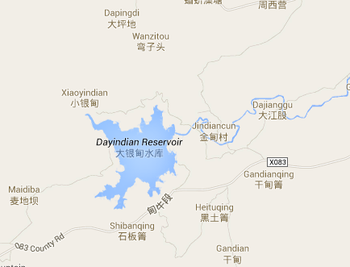
Compare with ArcGIS’ Sink
Number of Available Sinks (Cont’d)
ArcGIS even regarded a water reservoir as a sink.

Slide 20
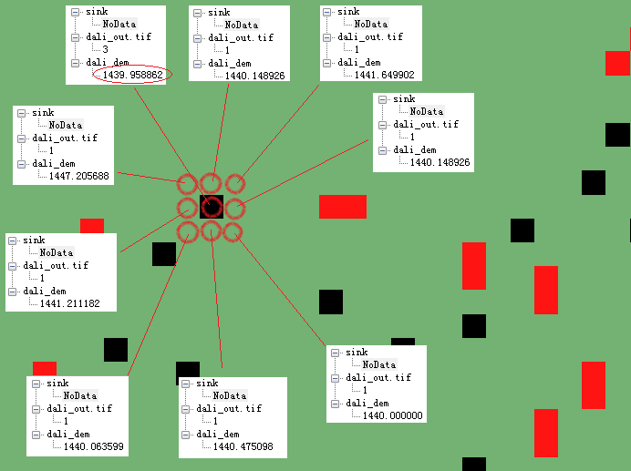
Compare with ArcGIS’ Sink
Number of Available Sinks (Cont’d)

Slide 21
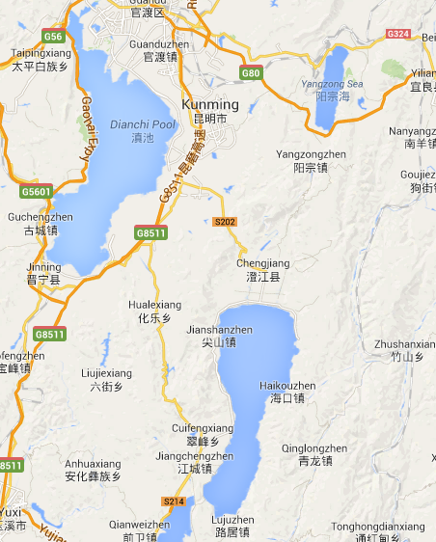
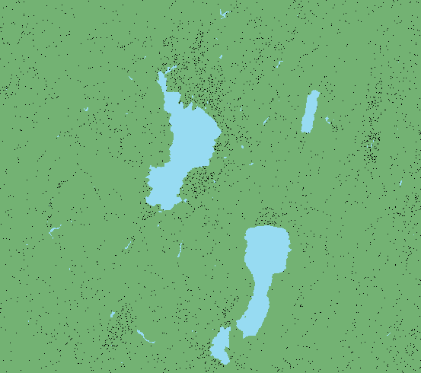
Implemention
Another sample around Dianchi Lake, Kunming, Yunnan Province, China

Slide 22
Thank you!
By Caiyi Zhong
May. 6th, 2014

